Slide 1

Chapter 6 The Link Layer
and LANs
Computer Networking: A Top-Down Approach 8th edition Jim Kurose, Keith Ross Pearson, 2020
Acknowledgement: Based on the textbook’s website: https://gaia.cs.umass.edu/kurose_ross/index.php
Notes:
Version History
8.0 (May 2020)
All slides reformatted for 16:9 aspect ratio
All slides updated to 8th edition material
Use of Calibri font, rather that Gill Sans MT
Add LOTS more animation throughout
lighter header font
Updated datacenter slides, day-in-the-life
8.2 (July 2023): changes from 8.0
Minor updates throughout, including removal of master/slave
A few new slides added (transportation analogy, UMass LAN example, extended LANs)
Couple of not-used slides now hidden.

Slide 2

Link layer, LANs: roadmap
introduction
error detection, correction
multiple access protocols
LANs
addressing, ARP
Ethernet
switches
VLANs
link virtualization: MPLS
data center networking
a day in the life of a web request

Slide 3
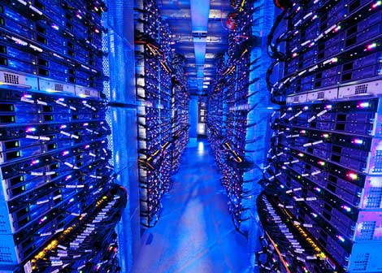
Datacenter networks
10’s to 100’s of thousands of hosts, often closely coupled, in close proximity:
e-business (e.g. Amazon)
content-servers (e.g., YouTube, Akamai, Apple, Microsoft)
search engines, data mining (e.g., Google)
challenges:
multiple applications, each serving massive numbers of clients
reliability
managing/balancing load, avoiding processing, networking, data bottlenecks
Inside a 40-ft Microsoft container, Chicago data center

Slide 4
Datacenter networks: network elements
Border routers
connections outside datacenter
Tier-1 switches
connecting to ~16 T-2s below
Tier-2 switches
connecting to ~16 TORs below
…
…
…
…
Top of Rack (TOR) switch
one per rack
100G-400G Ethernet to blades
…
…
…
…
Server racks
20- 40 server blades: hosts

Slide 5
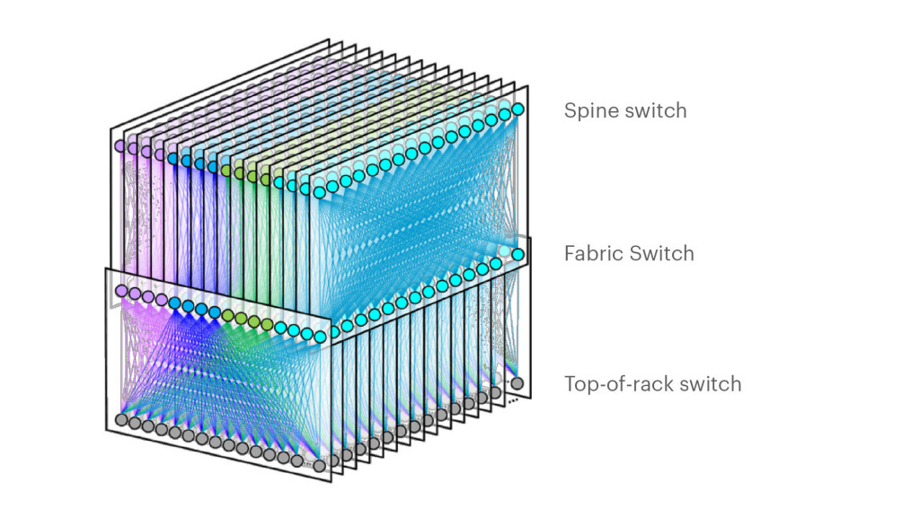
Datacenter networks: network elements
Facebook F16 data center network topology:
https://engineering.fb.com/data-center-engineering/f16-minipack/ (posted 3/2019)

Slide 6
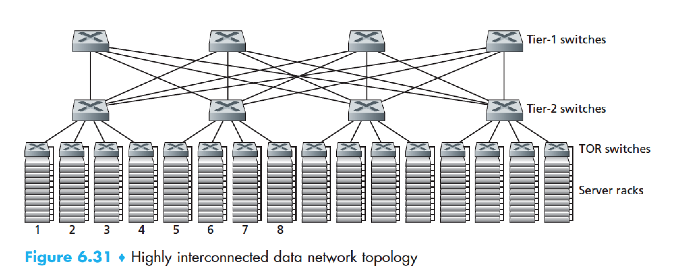
Datacenter networks: multipath
rich interconnection among switches, racks:
increased throughput between racks (multiple routing paths possible)
increased reliability via redundancy
9
10
11
12
13
14
15
16
two disjoint paths highlighted between racks 1 and 11

Slide 7
Datacenter networks: application-layer routing
Internet
load balancer: application-layer routing
receives external client requests
directs workload within data center
Load
balancer
…
…
…
…
returns results to external client (hiding data center internals from client)
…
…
…
…

Slide 8
Link layer, LANs: roadmap
introduction
error detection, correction
multiple access protocols
LANs
addressing, ARP
Ethernet
switches
VLANs
link virtualization: MPLS
data center networking
a day in the life of a web request

Slide 9
Synthesis: a day in the life of a web request
our journey down the protocol stack is now complete!
application, transport, network, link
putting-it-all-together: synthesis!
goal: identify, review, understand protocols (at all layers) involved in seemingly simple scenario: requesting www page
scenario: student attaches laptop to campus network, requests/receives www.google.com
A Day in the Life of a Web Request Retrospective
https://www.youtube.com/watch?v=I6twhxwycyM

Slide 10
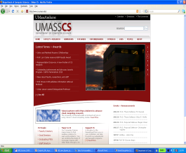



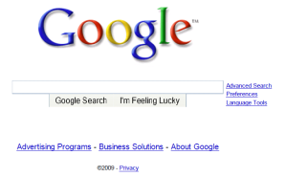
A day in the life: scenario
scenario:
DNS server
arriving mobile client attaches to network …
browser
Comcast network
68.80.0.0/13
requests web page: www.google.com
school network
68.80.2.0/24
web page
Sounds
simple!
web server
Google’s network
64.233.160.0/19
64.233.169.105

Slide 11
A day in the life: connecting to the Internet
DHCP
DHCP
UDP
IP
Eth
Phy
connecting laptop needs to get its own IP address, addr of first-hop router, addr of DNS server: use DHCP
DHCP
DHCP
DHCP
arriving mobile:
DHCP client
DHCP
DHCP request encapsulated in UDP, encapsulated in IP, encapsulated in 802.3 Ethernet
DHCP
DHCP
UDP
IP
Eth
Phy
DHCP
DHCP
DHCP
DHCP
Ethernet frame broadcast (dest: FFFFFFFFFFFF) on LAN, received at router running DHCP server
router has
DHCP server
Ethernet de-muxed to IP de-muxed, UDP de-muxed to DHCP

Slide 12

A day in the life: connecting to the Internet
DHCP
UDP
IP
Eth
Phy
DHCP server formulates DHCP ACK containing client’s IP address, IP address of first-hop router for client, name & IP address of DNS server
DHCP
DHCP
DHCP
arriving mobile:
DHCP client
DHCP
encapsulation at DHCP server, frame forwarded (switch learning) through LAN, demultiplexing at client
DHCP
DHCP
UDP
IP
Eth
Phy
DHCP
DHCP
DHCP
DHCP
router has
DHCP server
DHCP client receives DHCP ACK reply
Client now has IP address, knows name & addr of DNS
server, IP address of its first-hop router

Slide 13
A day in the life… ARP (before DNS, before HTTP)
DNS
DNS
UDP
IP
Eth
Phy
before sending HTTP request, need IP address of www.google.com: DNS
DNS
DNS
ARP
ARP query
arriving mobile:
ARP client
DNS query created, encapsulated in UDP, encapsulated in IP, encapsulated in Eth. To send frame to router, need MAC address of router interface: ARP
ARP
ARP query broadcast, received by router, which replies with ARP reply giving MAC address of router interface
ARP reply
Eth
Phy
router has
ARP server
client now knows MAC address of first hop router, so can now send frame containing DNS query

Slide 14
A day in the life… using DNS
DNS
DNS
DNS
DNS
DNS
DNS
UDP
IP
Eth
Phy
de-muxed to DNS
DNS replies to client with IP address of www.google.com
DNS
DNS
UDP
IP
Eth
Phy
DNS
DNS
DNS
DNS
DNS
DNS
server
DNS
DNS
Comcast network
68.80.0.0/13
IP datagram containing DNS query forwarded via LAN switch from client to 1st hop router
IP datagram forwarded from campus network into Comcast network, routed (tables created by RIP, OSPF, IS-IS and/or BGP routing protocols) to DNS server

Slide 15
A day in the life…TCP connection carrying HTTP
DNS
DNS
DNS
HTTP
HTTP
TCP
IP
Eth
Phy
to send HTTP request, client first opens TCP socket to web server
SYNACK
SYN
SYNACK
SYN
SYNACK
SYN
SYN
Comcast network
68.80.0.0/13
TCP SYN segment (step 1 in TCP 3-way handshake) inter-domain routed to web server
TCP
IP
Eth
Phy
web server responds with TCP SYNACK (step 2 in TCP 3-way handshake)
SYNACK
SYN
SYNACK
SYN
SYNACK
SYNACK
SYN
TCP connection established!
Google web server
64.233.169.105

Slide 16
A day in the life… HTTP request/reply
DNS
DNS
DNS
HTTP
HTTP
TCP
IP
Eth
Phy
HTTP request sent into TCP socket
HTTP
HTTP
HTTP
web page finally (!!!) displayed
HTTP
HTTP
HTTP
HTTP
HTTP
IP datagram containing HTTP request routed to www.google.com
Comcast network
68.80.0.0/13
web server responds with HTTP reply (containing web page)
HTTP
HTTP
TCP
IP
Eth
Phy
HTTP
HTTP
HTTP
HTTP
IP datagram containing HTTP reply routed back to client
Google web server
64.233.169.105

Slide 17
Chapter 6: Summary
principles behind data link layer services:
error detection, correction
sharing a broadcast channel: multiple access
link layer addressing
instantiation, implementation of various link layer technologies
Ethernet
switched LANS, VLANs
virtualized networks as a link layer: MPLS
synthesis: a day in the life of a web request

Slide 18
Chapter 6: let’s take a breath
journey down protocol stack complete (except PHY)
solid understanding of networking principles, practice!
….. could stop here …. but more interesting topics!
wireless
security

